Slide 1
Travel Blog-Ilocos Escapade
Topics
Purpose
My purpose is to document an individual’s adventures and traveling experiences.
It is a great way for friends and family to follow along with your travels and re-live your own journeys.
This travel blog is a platforms that can also be set up on social media channels like Facebook or Instagram. Anywhere you feel the most comfortable and have access to the audience of your choice can be an excellent place to share this wonderful experiences.

Slide 2




Ilocos Escapade
Site Map
HOME
GALLERY
WHAT TO DO
WHERE TO STAY
ABOUT
BEACH
LINKS
LINKS
CHURCH
EXTREME
HOTELS
GET TO KNOW ME
FOODS
EXPLORE
RESORTS
OTHERS
EAT
HAVE SOME FUN

Slide 3

Wire Frame

Slide 4
Wire Frame

Slide 5
Wire Frame

Slide 6


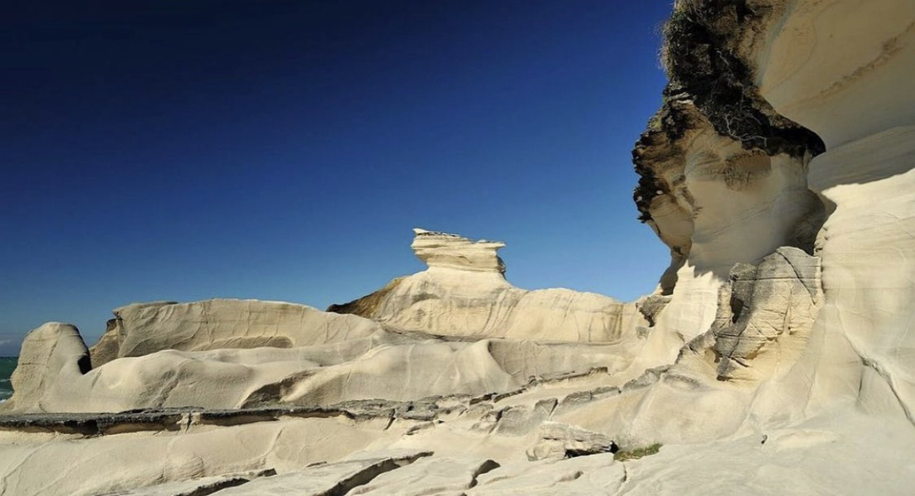

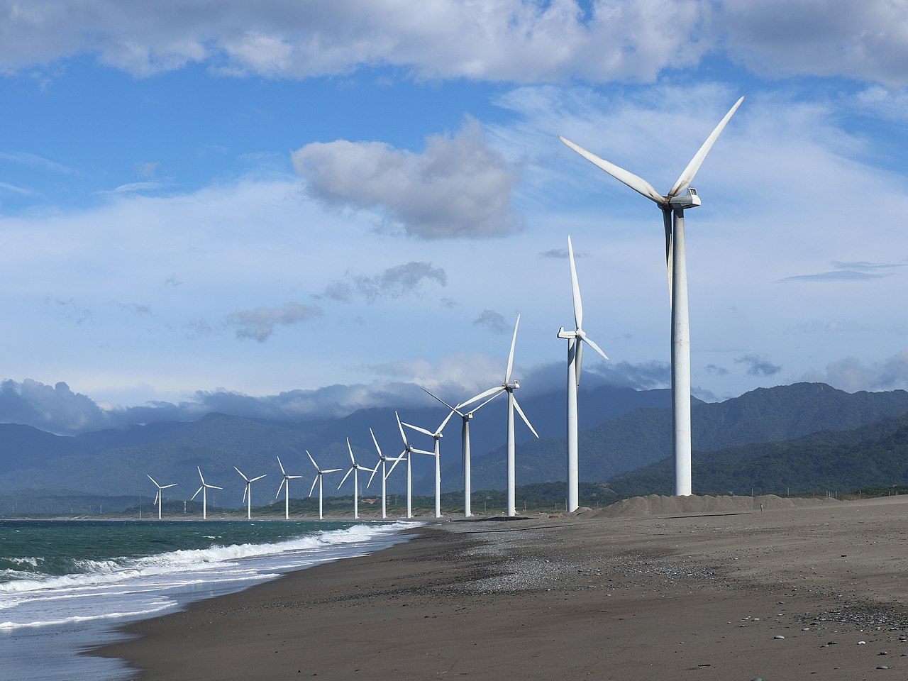


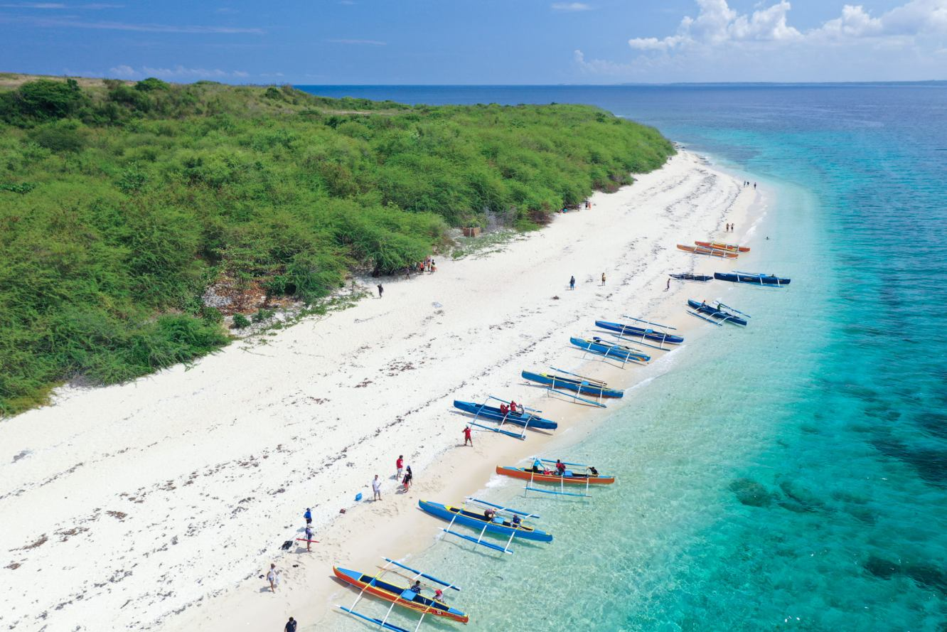
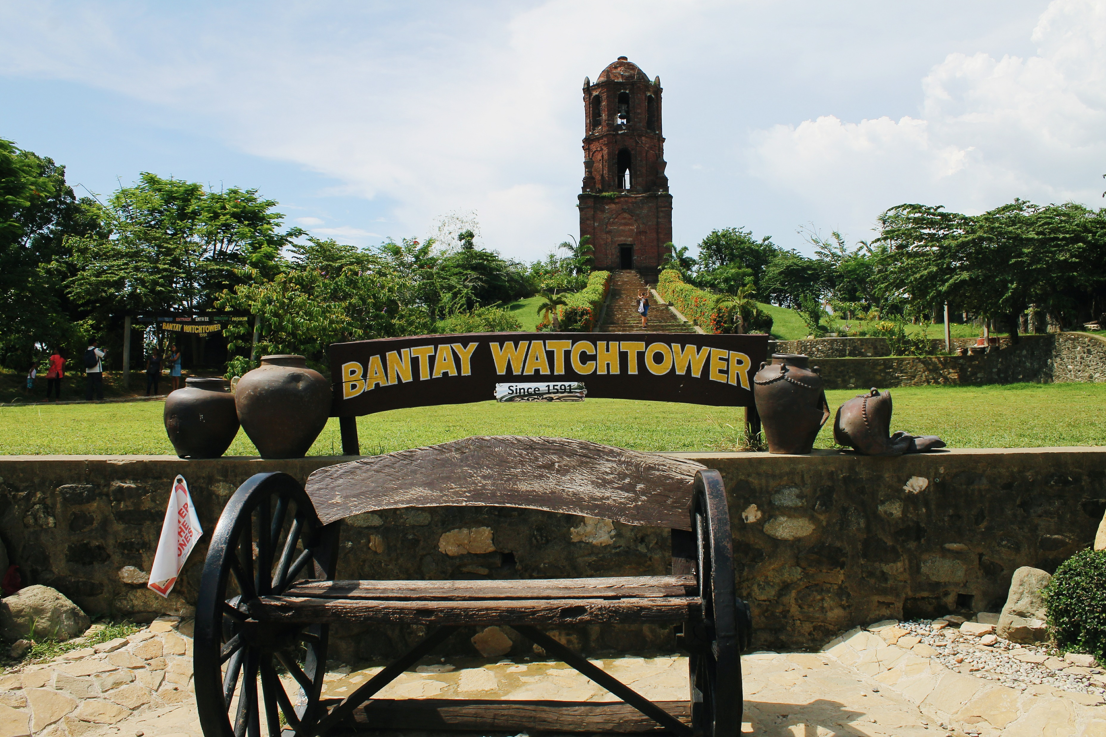
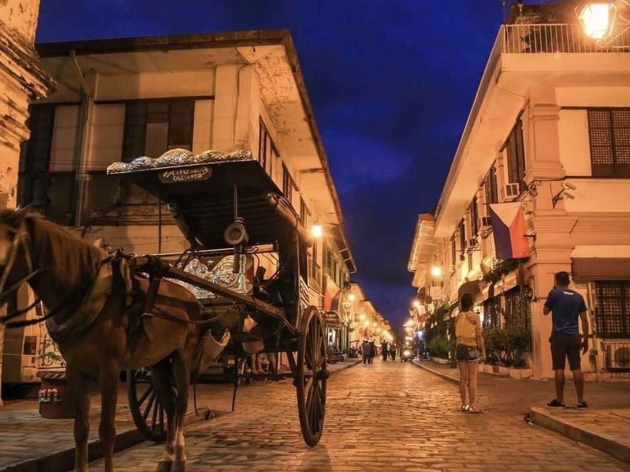



Mood Board
Cherish this Memories

